Slide 1
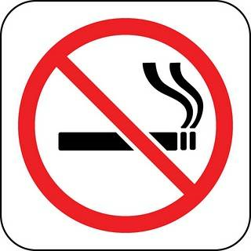
‘World No Tobacco Day, 31 May’ (2022)
Fight Against Tobacco Industry is the Professional Responsibility of Health Workers
in the Aim of a Healthy Community

